Slide 1

Project to establish an efficient CI/CD pipeline containing three virtual machines where changes to the Ansible playbook hosted in private GitLab instance on second VM trigger automated deployments of Apache HTTP Server on the third VM, with integrated notifications for pipeline status and relevant information about users.
Candidate Name: Salma Salah
Assigned to: Eng. Amr

Slide 2
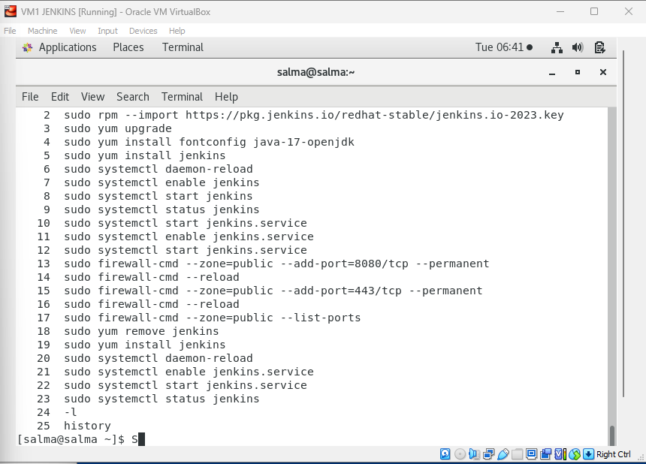
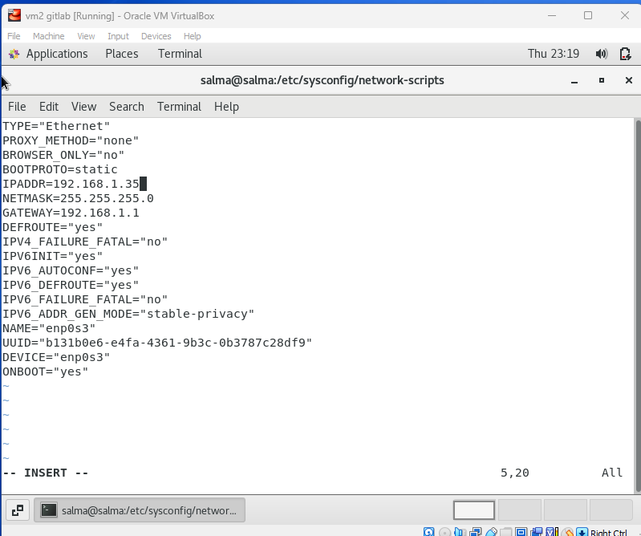
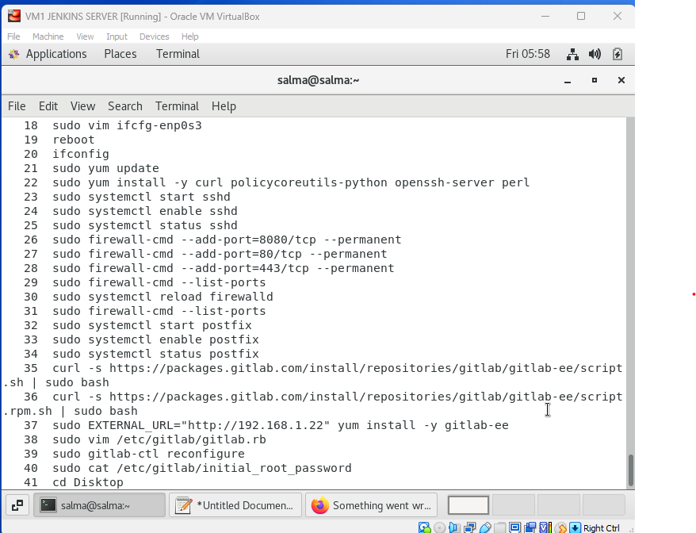
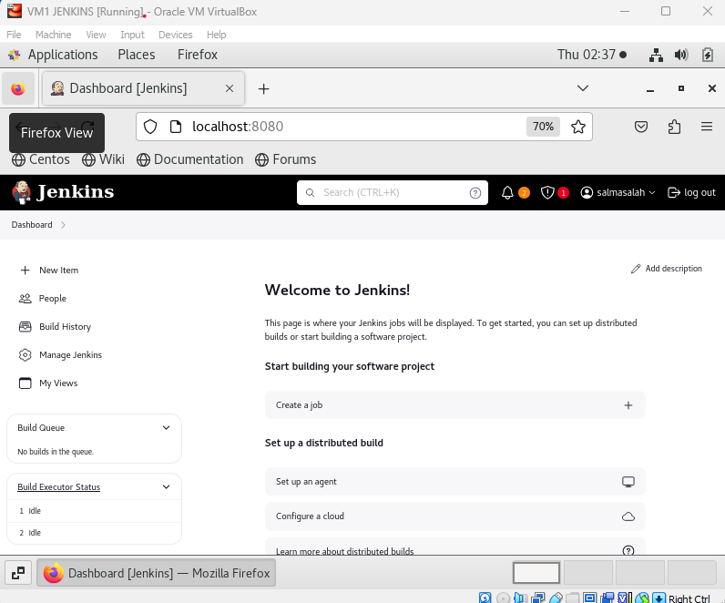
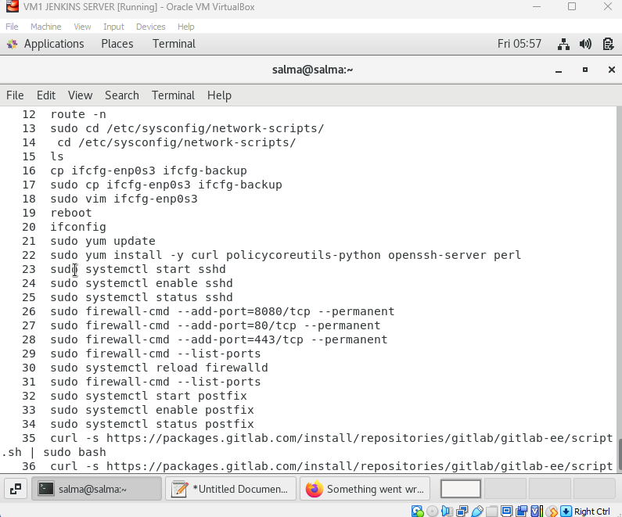
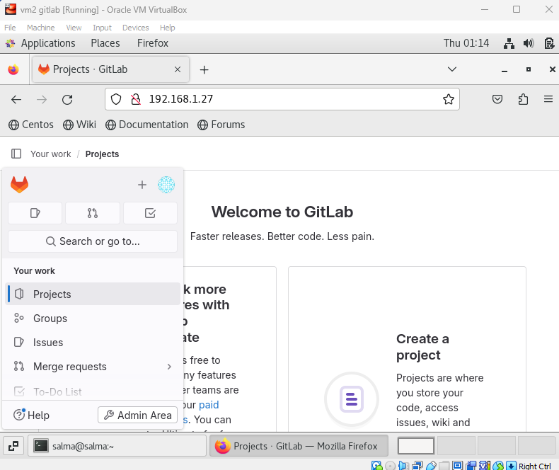
Step 1
Installing Jenkins on VM1 and GitLab on VM2
1) Installing Jenkins
3)Installing GitLab and getting root password to login with
2)Configuring VM2 to have static IP Address

Slide 3
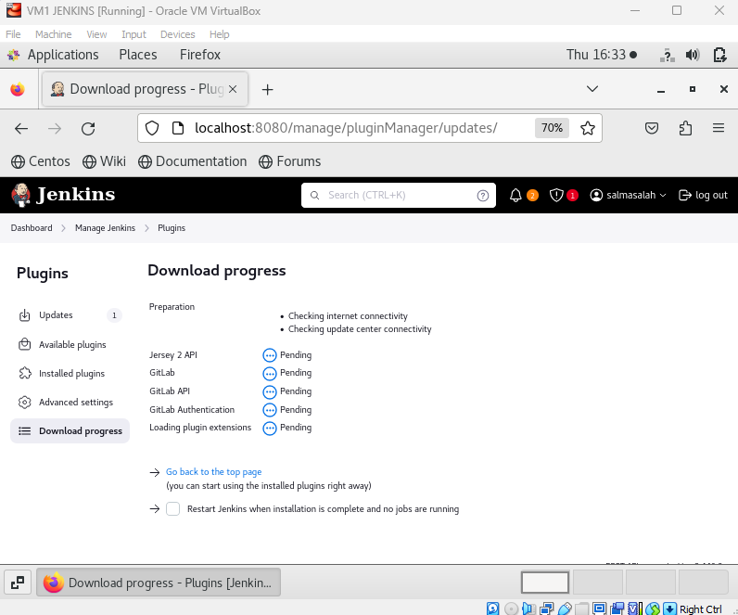
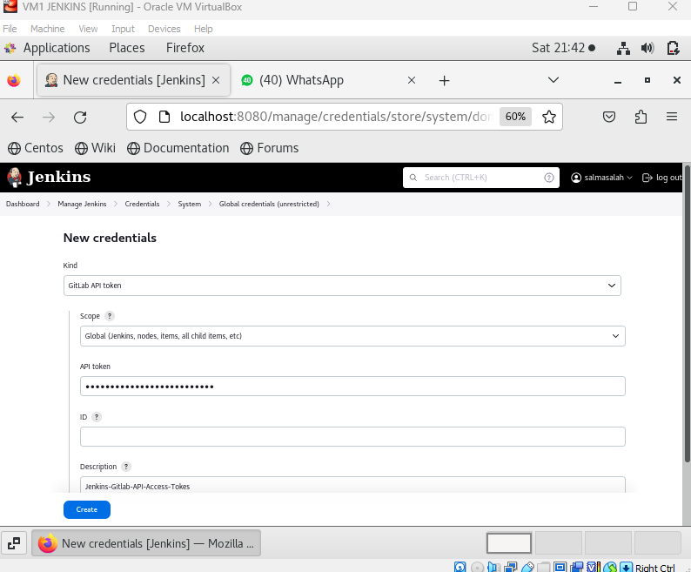
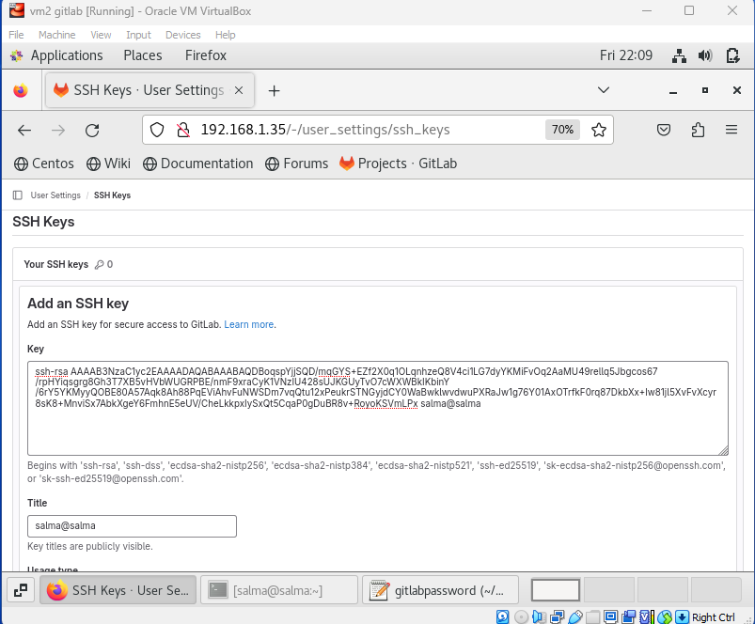
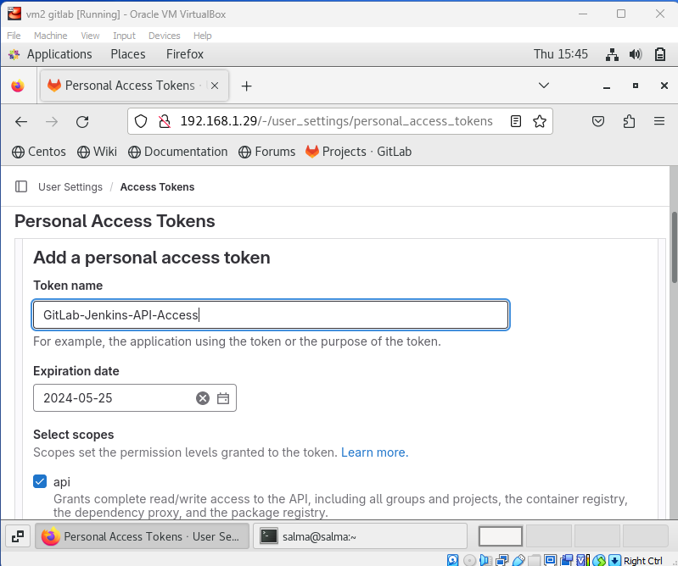
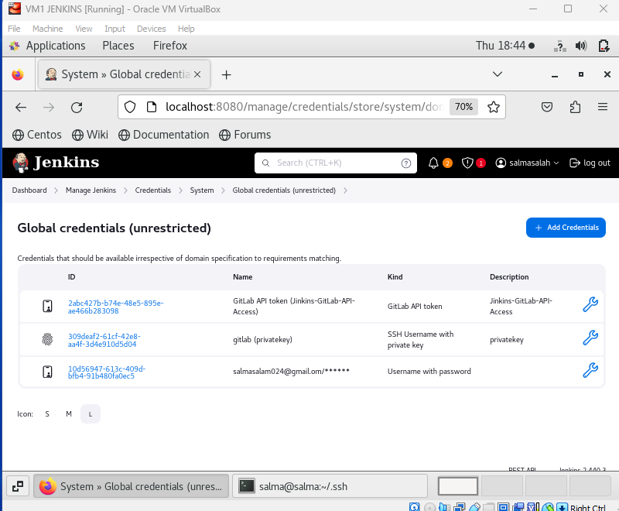
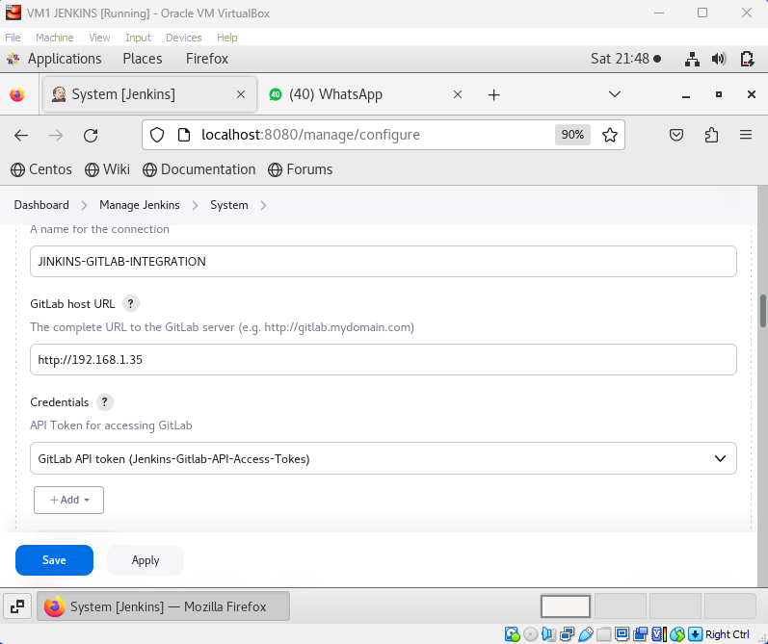
Step 2
Jenkins Integration With GetLab
1)Installing Required Plugins
3) Adding token to jenkins
5) Adding key to Ansible
4) Creating SSH key
6) Testing Connection
2)Creating API Token

Slide 4
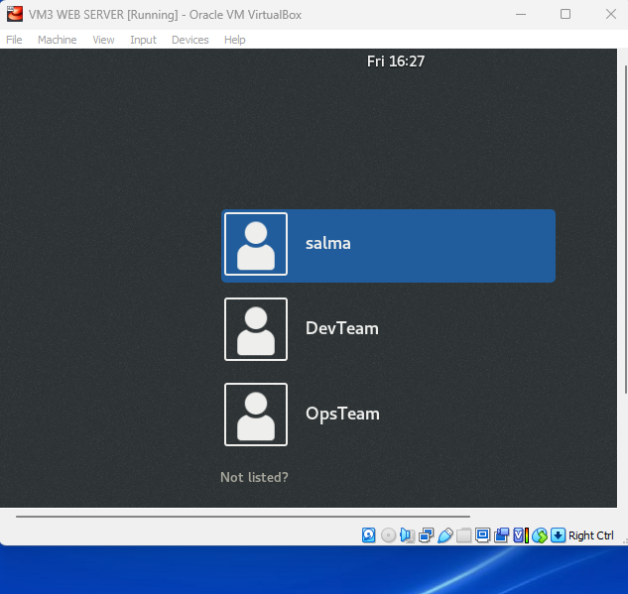
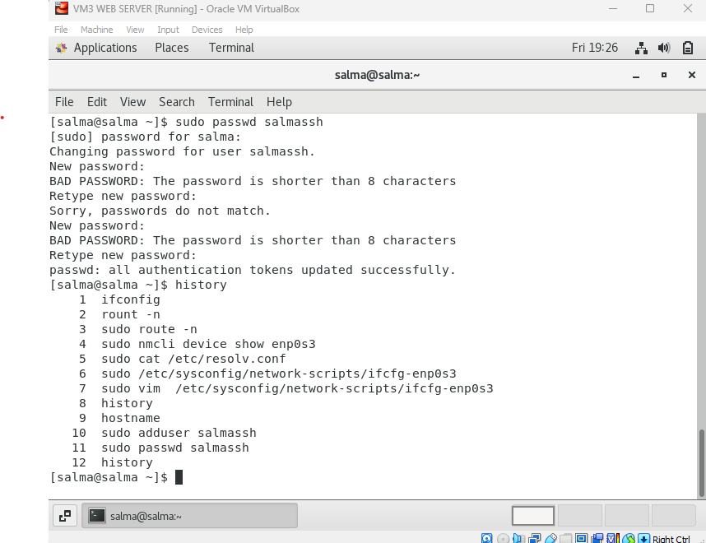
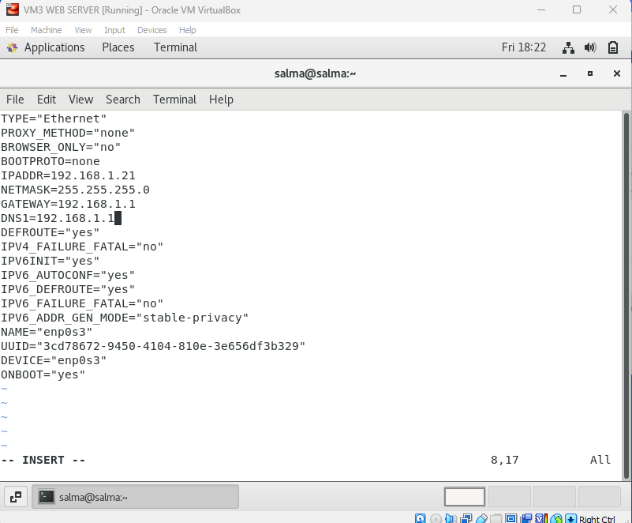
Step3
Configurations onVM3
1) Running bash script to create users DevTeam & OpsTeam
2)Making IP address STATIC to be used in Ansible Inventory
3)Making SSH user to to be used in Ansible Inventory

Slide 5
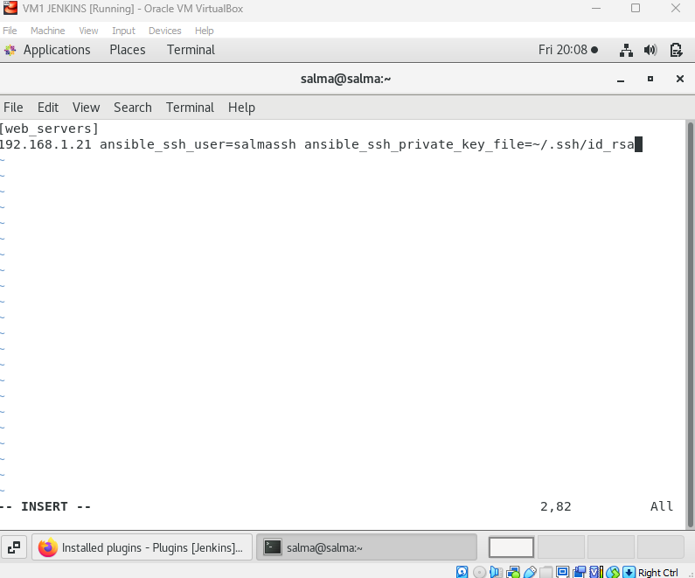
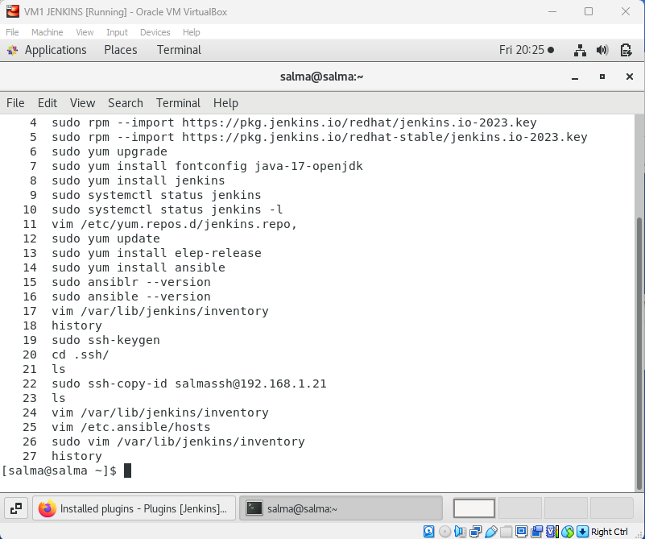
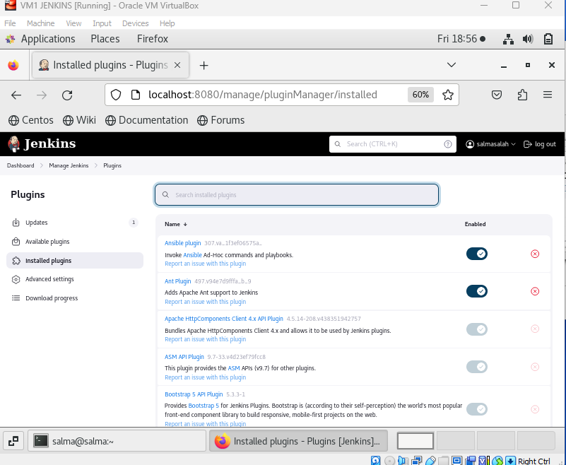
Step 4
Ansible Installation and Integration with Jenkins
Install Ansible
Generate Public and private keys and copy the public to (VM3)
3) Configure Ansible Inventory and add IP Address of target machine (VM3) and ssh user name that was created on previous step and add path to private ssh key
4) Install Ansible Plugin in Jenkins

Slide 6
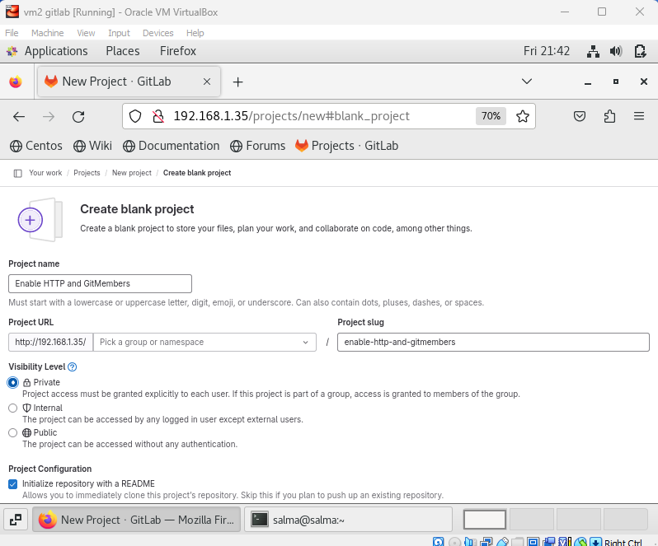
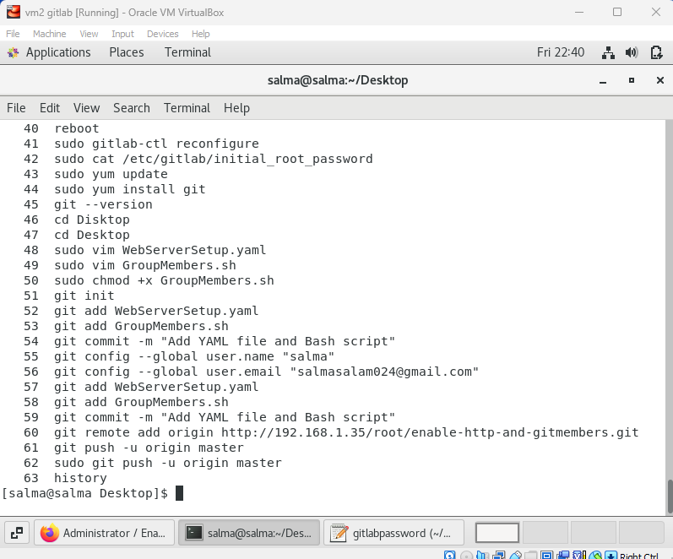
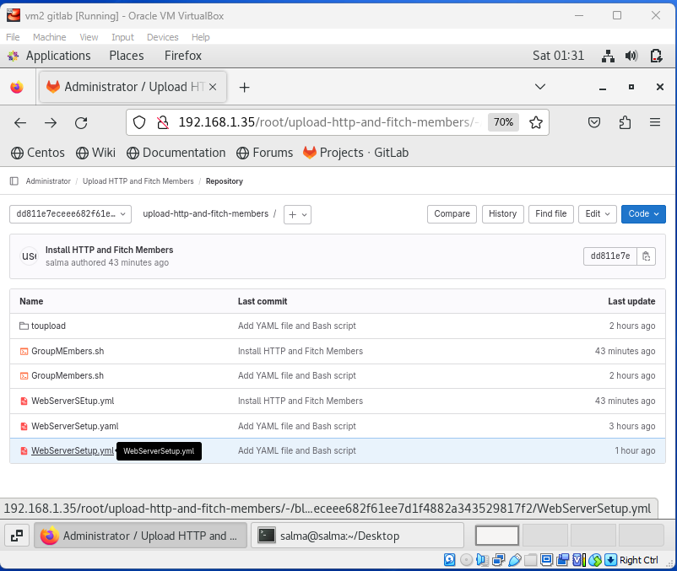
Step 5
Git Installation and push files into GitLab Repo
1)Install Git on VM2
2) Making a new repository
3) Push (WebSErver.yml) &(GetMEmbers.sh) into the Rebo

Slide 7
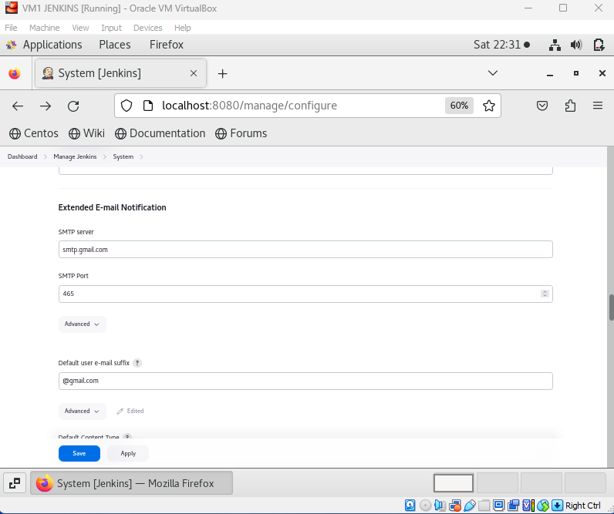
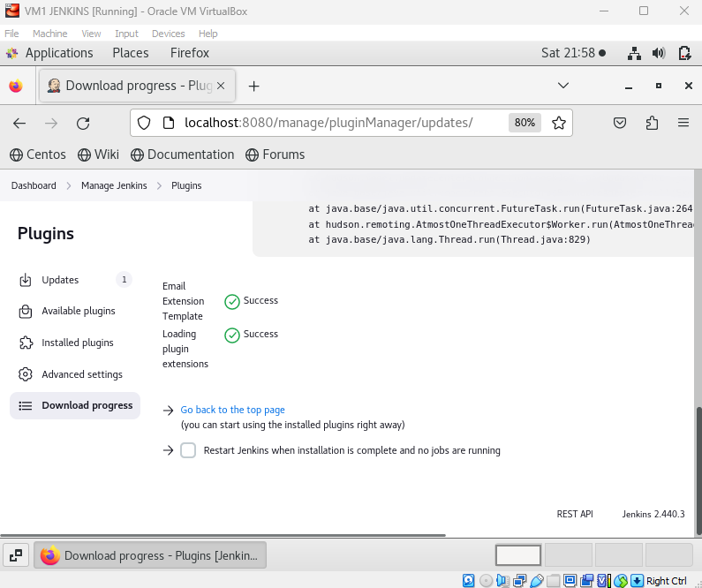
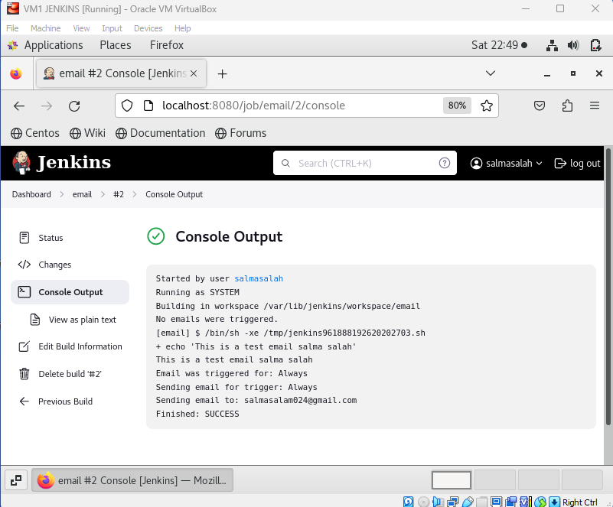
Step 6
Setting Up Email Notification in Jenkins
1) Install Email Extension Plugin
2) Configure Email Notification Settings
3) Create a project to test if email notification is working and it ‘s successful

Slide 8
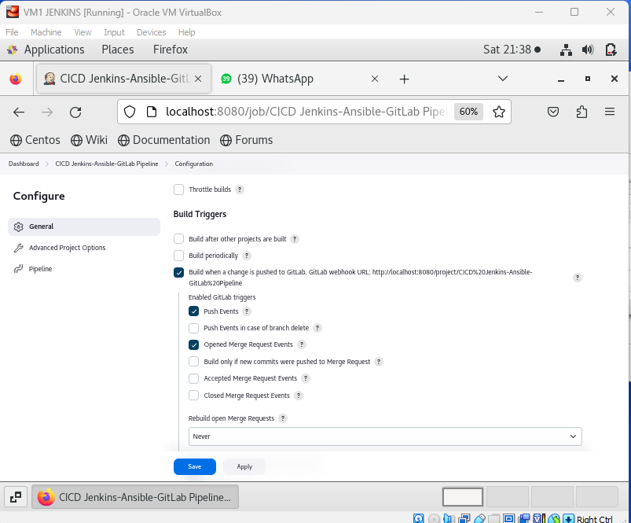
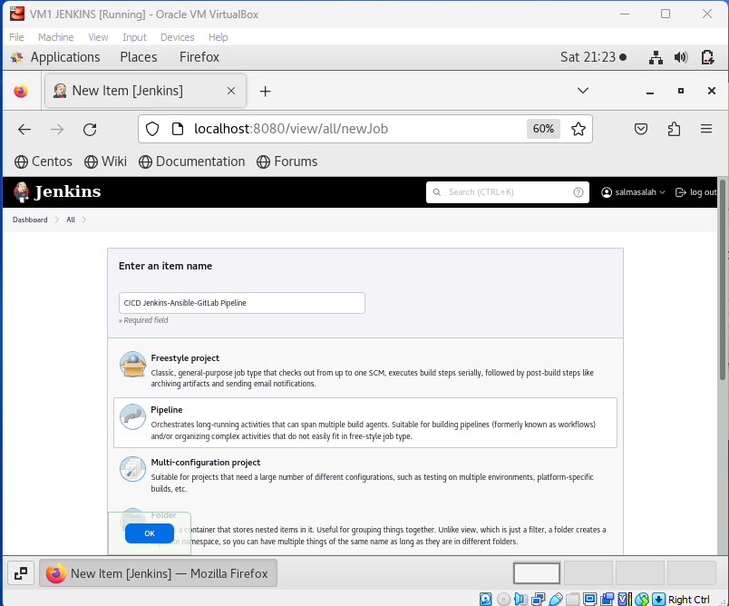
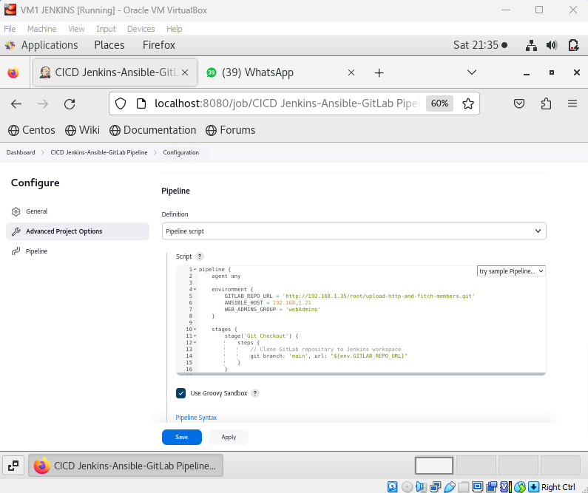
Step 7
PipeLine Configuration
1)Create a new project
2) Add pipeline configurations and built triggers
3) Add Pipeline Script

